Slide 1

Data Communication & Networks
Spring-2021
(Week-4)
Course Teachers: Mr. Waleej Haider (Asst. Prof),
Ms. Razia Nisar Noorani (Asst. Prof)
Department of Computer Science & Information Technology

Slide 2
Data Transmission

Slide 3
Objectives of Today’s Lecture
We will learn about :
Analog vs Digital signals
Simple vs Composite signals
Periodic vs Non-Periodic signals
Frequency, wavelength, spectrum & bandwidth
Transmission of digital signals
Bit rate, bit length, Baud rate
Channel Capacity
Bandwidth Categories

Slide 4
Signals
Signal is the electric or electromagnetic representation of data
An electromagnetic signal is generated by the transmitter and then transmitted over a medium
Signals can also be analog or digital
Analog signal
Signal intensity varies in a smooth way over time
It has infinitely many levels of intensity (values) along its path over a period of time
There are no breaks or discontinuities in the signal e.g; speech
Digital signal
Signal intensity maintains a constant level for some period of time and then changes to another constant level e.g; binary 1s and 0s
A digital signal can have only a limited number of defined values (often 0 and 1)
A Signal is a function of time, but it can also be expressed as a function of frequency
There are two concepts of data transmission Time domain view and frequency domain view of a signal

Slide 5
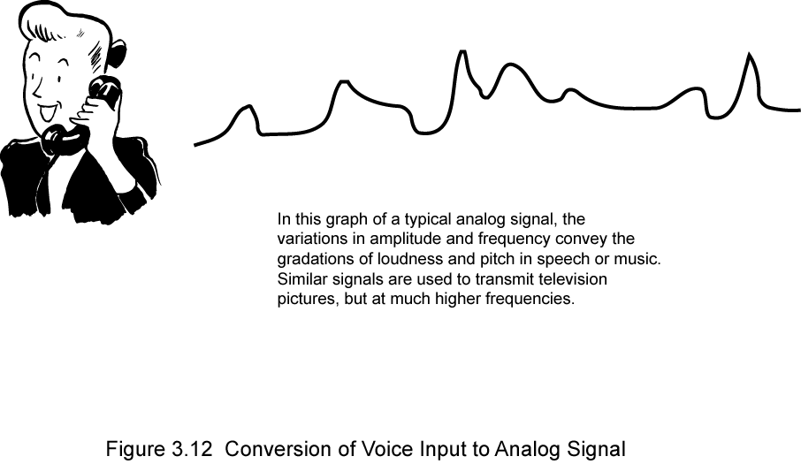
Analog Data
Analog data take on continuous values in some interval
E.g. voice, video, temperature, and pressure are continuously varying patterns of intensity
freq range of sound wave is 20Hz-20kHz
human speech spectrum range is 100Hz-7kHz
Audio signals are easily and directly converted into electromagnetic signals
All sound freqs, whose amplitude is measured in terms of loudness, are converted into electromagnetic freqs, whose amplitude is measured in volts
The standard spectrum for a voice channel is 300-3400Hz
Notes:
5

Slide 6
Digital Data
Digital data take on discrete values e.g. text, integers, etc
Textual data cannot be easily stored or transmitted by data processing and communication systems
Communication systems are designed for binary data
Therefore some text codes have been devised by which characters are represented by a sequence of bits
Commonly used text code: IRA (international reference alphabet)
IRA-encoded characters are using 8 bits per character
8th bit is a parity bit used for error detection
Thus binary data is generated by terminals and computers etc and then converted into digital voltage pulses for transmission
The signal uses two constant dc components (voltage levels) 0 or 1
2-6

Slide 7
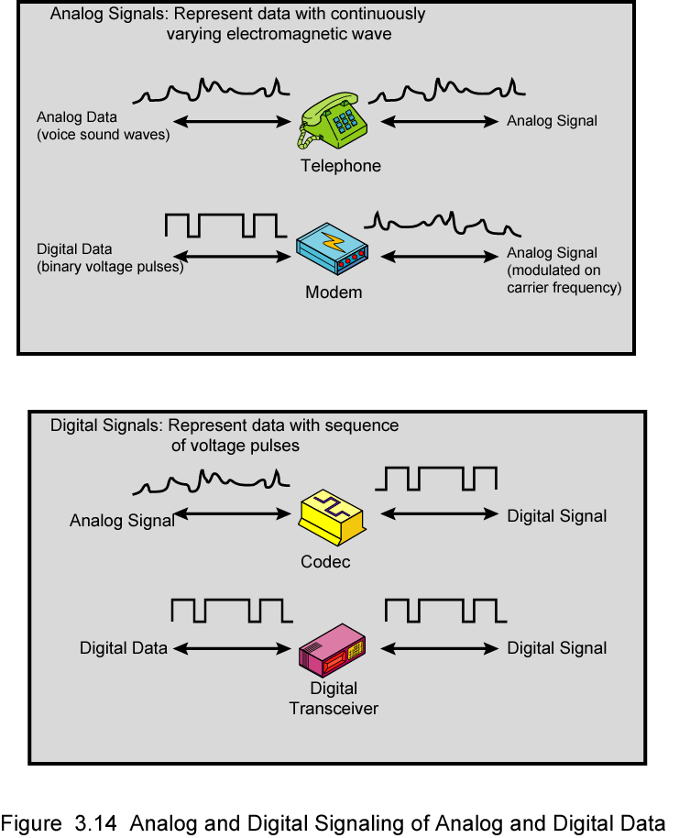
Analog Signals
Notes:
7

Slide 8
Digital Signals
Notes:
8

Slide 9
Time Domain Concepts
Time Domain Concepts:
Electromagnetic signals are viewed as a function of time
The time-domain plot shows changes in signal amplitude with respect to time
It is an amplitude-versus-time plot

Slide 10
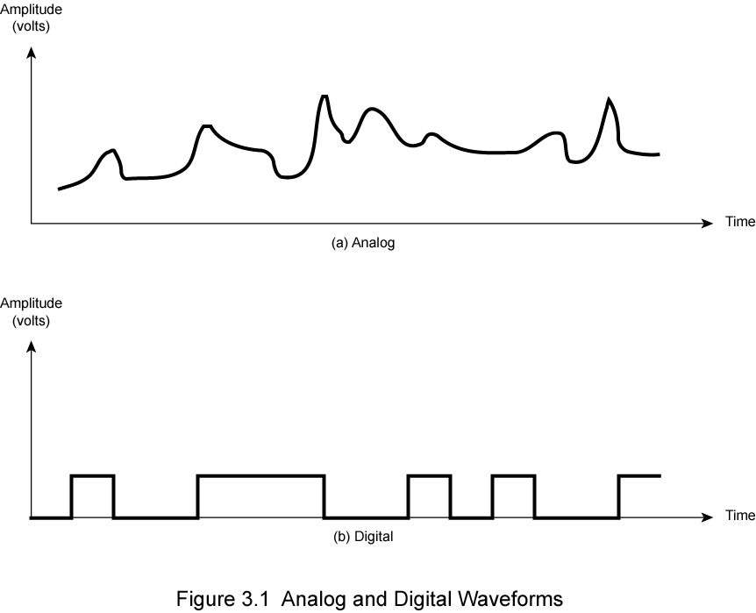
Analogue & Digital Signals
(continuous)
(discrete)
Analog and Digital Waveforms

Slide 11
Periodic and Non-periodic Signals
Periodic signal
A signal completes a pattern within a measurable time frame called a Period
one full pattern is called a cycle
If same signal pattern repeats over subsequent identical periods called periodic signal
Non-periodic signal
pattern not repeated over time
Both analog and digital signals can be periodic or non-periodic
(a) shows periodic continuous signal (sine wave)
(b) shows periodic discrete signal (square wave)
In data comm., we commonly use periodic analog signals and non-periodic digital signals

Slide 12
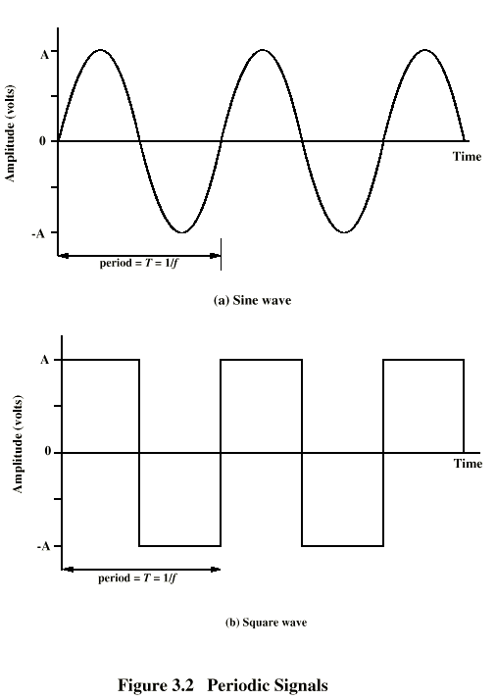
Cont.. example

Slide 13
Sine Wave
Sine wave is the fundamental periodic analog signal
Its change over the course of a cycle is smooth and consistent
It is a continuous rolling flow
Each cycle consists of a single are above the time axis followed by a single are below it (shown in previous fig.)
It is represented by three parameters:
Peak amplitude (A)
Highest intensity (value) of a signal over time
Proportional to the energy it carries
Measured in volts
frequency (f)
Number of cycles per second
Rate of change of signal (rate at which signal repeats)
Measured in Hertz (Hz)
period = time required for one repetition (one cycle) =T
T = 1/f or f = 1/T
Period and frequency are the inverse of each other

Slide 16
Cont..
Frequency is the rate of change with respect to time
Change in a short span of time means high freq
Change over a long span of time means low freq
If signal does not change at all, its freq is zero
Any electromagnetic signal consists of a collection of periodic analog signals (sine waves) at different amplitude, frequencies, and phases

Slide 17
Cont..
3) Phase (φ)
Phase describes the position of the waveform relative to time 0
Measure of the relative position in time within a single period of signal
Phase is the fractional part t/T of the period T through which t has advanced relative to an arbitrary origin
If we think of the wave as something that can be shifted backward or forward along the time axis, phase describes the amount of that shift
The origin is usually taken as the last previous passage through zero
φ is sometimes referred to as a phase-shift, because it represents a "shift" from zero phase.
Phase shift is any change that occurs in the phase of one signal, or in the phase difference between two or more signals.

Slide 18
Cont..
Phase is measured in degrees or radians
360° is 2π rad; 1° is 2π/360 rad; and 1 rad is 360/(2 π)
A phase shift of 360° corresponds to a shift of a complete period
a phase shift of 180° corresponds to a shift of one-half of a period; and
a phase shift of 90° corresponds to a shift of one-quarter of a period (see Figure).

Slide 20
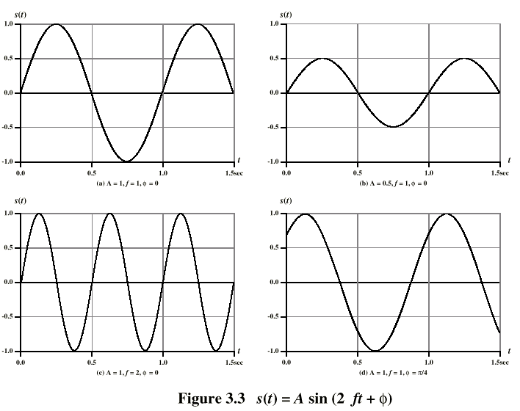
Varying Sine Waves s(t) = A sin(2πft +Φ)

Slide 21
Wavelength (λ)
Wavelength of a signal is the distance traveled by one cycle
Distance between two points of corresponding phase of two consecutive cycles
Wavelength can be calculated if one is given the propagation speed and the period of the signal.
Assume signal is traveling with velocity v then λ = vT
or equivalently λ = v/ f
wavelength is normally measured in micrometers (μm)

Slide 22
Frequency Domain Concept
Time-domain plot shows changes in signal amplitude with respect to time
A frequency-domain plot is concerned with only the peak value and the frequency of the signal as a whole.
Changes of amplitude during one period are not shown.
A complete sine wave in the time domain can be represented by one single spike in the frequency domain. (see fig)
The position of the spike shows the frequency and its height shows the peak amplitude

Slide 24
Cont..
The frequency domain is more compact and useful when we are dealing with more than one sine wave.
Figure below shows three sine waves, each with different amplitude and frequency.
All can be represented by three spikes in the frequency domain

Slide 25
Composite Signals
A single frequency sine wave is not useful in data communications
If we had only one single sine wave to convey a conversation over the phone, it would make no sense and carry no information. We would just hear a buzz
we need to send a composite signal to communicate data.
Any composite signal is a combination of simple sine waves with different frequencies, amplitudes, and phases as shown in fig (c)
The fig (a) fig (b) shows the components of fig (c) which are just simple sine waves of frequencies f and 3f
Their sine waves are:
Fig (a): s(t) = sin(2πft)
Fig (b): s(t) = (1/3) sin(2π(3f)t)
The second freq is the integer multiple of the first freq.
Thus first freq component is called Fundamental freq.
The period of the composite signal is equal to the period of the fundamental freq as in fig (c)
The composite signal generated from fig (a) & (b) will be:
Fig (c): s(t) = (4/ π) [sin(2πft) + (1/3) sin(2π(3f)t)]

Slide 26
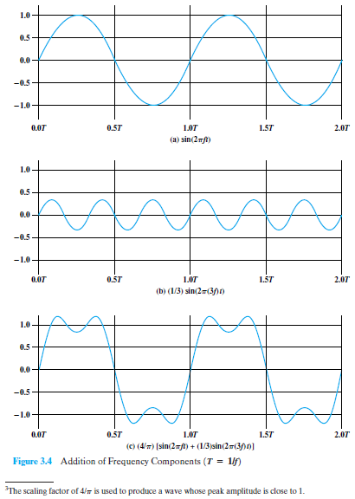
Decomposition of a composite signal in time domain

Slide 27
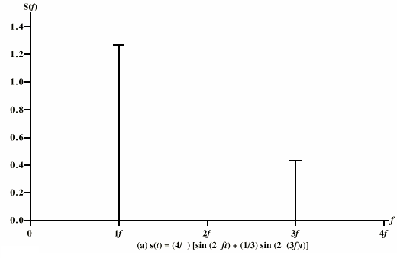
Frequency Domain Representations
Fig (d): Frequency-domain decomposition of the composite signal of Fig (c)

Slide 28
Periodic/ Non- Periodic Composite signals
A composite signal can be periodic or non-periodic
A periodic composite signal can be decomposed into a series of simple sine waves with discrete frequencies.
Discrete Frequencies have integer values (1, 2, 3, ……)
A non-periodic composite signal can be decomposed into a combination of an infinite number of simple sine waves with continuous frequencies
Continuous Frequencies have real values.
For composite periodic signal see previous fig (c)
Fig (a) & (b) shows decomposition of fig (c)
For its freq-domain decomposition see fig (d), it shows discrete frequencies

Slide 29
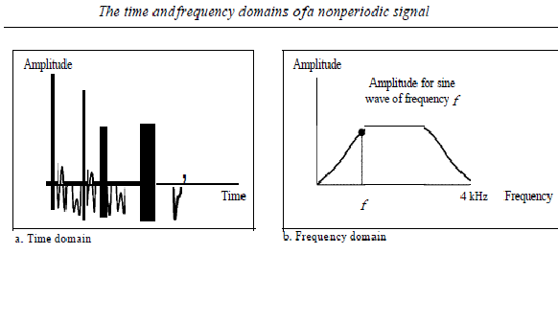
Example: Non-periodic Composite Signal

Slide 30
Example (Cont..)
There are an infinite number of simple sine frequencies (waves) in a non-periodic composite signal created by a microphone
A normal human being can create a continuous range of frequencies between 0 and 4 kHz
Frequency decomposition of this signal produces a continuous curve.
There are an infinite number of frequencies between 0.0 and 4000.0 (real values).
The height of the vertical line is the amplitude of the corresponding frequency

Slide 31
Spectrum & Bandwidth
Spectrum of a signal
range of frequencies contained in a composite signal
For the signal of fig (c), the spectrum extends from f to 3f
Bandwidth of a signal
Width of the spectrum (diff. b/w max & min freq of the spectrum)
In case of fig (c), the bandwidth is 2f
Effective bandwidth
Most of the composite signal energy is contained in a relatively narrow band of frequencies
This band is called effective bandwidth
often called bandwidth

Slide 32
Fig. shows the spectrum and bandwidth
(a) All integer frequencies between 1000 and 5000
(b) frequencies are continuous between 1000 and 5000
High amplitude at the center of both figs shows effective bandwidth

Slide 33
Digital Signal
An electronic signal transmitted as binary code that can be either the presence or absence of current, high and low voltages or short pulses at a particular frequency
An arbitrary bit stream; 1 can be encoded as a high (positive) voltage and 0 as low (non-positive) voltage
Digital format is ideal for electronic communication as the string of 1s and 0s can be transmitted by a series of "on/off" signals represented by pulses of electricity or light.
A pulse "on" can represent a 1, and the lack of a pulse "off" can represent a 0
Most digital signals are non periodic
A digital signal can have more than two levels
In this case, we can send more than 1 bit for each level (see fig)
(a) shows 1 bit per level
(b) shows 2 bits per level
If a signal has L levels then no. of bits per level = log₂ L

Slide 34
Signal Element Versus Data Element
In data communications, our goal is to send data elements
A data element is the smallest entity that can represent a piece of information: this is the bit.
In digital data communications, a signal element carries data elements.
A signal element is the shortest unit (time wise) of a digital signal.
data elements are what we need to send; signal elements are what we can send.
Data elements are being carried; signal elements are the carriers.

Slide 35
Data Rate or Bit Rate
The data rate defines the number of data elements (bits) sent in 1 sec.
The unit is bits per second (bps)
The data rate is sometimes called the bit rate
Frequency is not appropriate characteristic for digital signal
The term-bit rate is used to describe digital signals

Slide 36
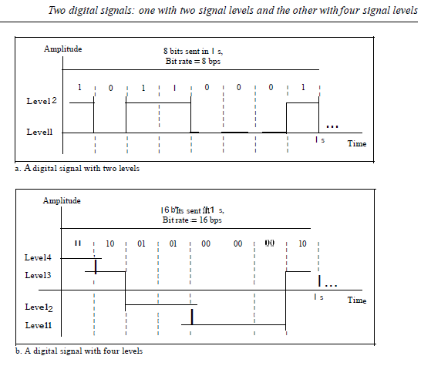

Slide 37
Bit Length
The concept of wavelength is for an analog signal: that is the distance one cycle occupies on the transmission medium.
For a digital signal Bit length is used instead of wavelength.
Bit length is the distance one bit occupies on the transmission medium.

Slide 38
Digital Signal as a Composite Analog Signal
Based on Fourier analysis, a digital signal is a composite analog signal.
Having only infinite bandwidth
A digital signal, in the time domain (see fig), comprises connected vertical and horizontal line segments.
A vertical line in the time domain means a frequency of infinity (sudden change in time)
A horizontal line in the time domain means a frequency of zero (no change in time).
Going from a frequency of zero to a frequency of infinity (and vice versa) implies all frequencies in between are part of the domain. Hence infinite bandwidth
If the digital signal is periodic, which is rare in data communications, the decomposed signal has a frequency domain representation with an infinite bandwidth and discrete frequencies (see fig).
If the digital signal is non-periodic, the decomposed signal still has an infinite bandwidth, but the frequencies are continuous (see fig)

Slide 39
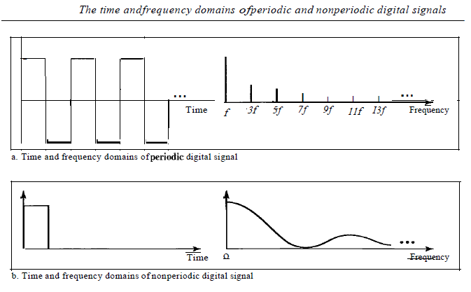

Slide 40
Transmission of Digital Signals
Thus a digital signal, periodic or non-periodic, is a composite analog signal with frequencies between zero and infinity.
In data communications, we consider the case of a non-periodic digital signal.
A digital signal can be transmitted by using one of two different approaches:
baseband transmission or
broadband transmission (using modulation).

Slide 41
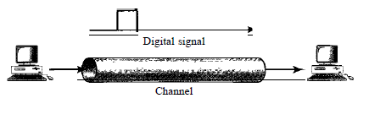
Baseband Transmission
Means sending a digital signal over a channel without changing to an analog signal. See Fig below
Baseband transmission requires a low-pass channel
It is a channel with a bandwidth that starts from zero freq..
This is, the entire bandwidth of a cable connecting two computers is one single channel (a dedicated medium)
Baseband transmission of a digital signal that preserves the entire shape (bandwidth) of the digital signal is possible only if we have a low-pass channel with an infinite or very wide bandwidth e.g; coaxial cable or fiber optic
It will also be needed to send bits faster

Slide 42
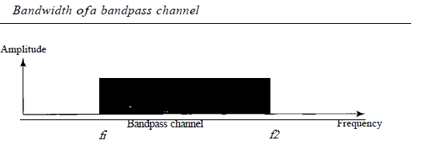
Broadband Transmission (Using Modulation)
Broadband transmission means changing the digital signal to an analog signal for transmission.
Modulation allows us to use a Bandpass channel
It is a channel with a bandwidth that does not start from zero freq.
we cannot send the digital signal directly to this channel; we need to convert the digital signal to an analog signal before transmission

Slide 43
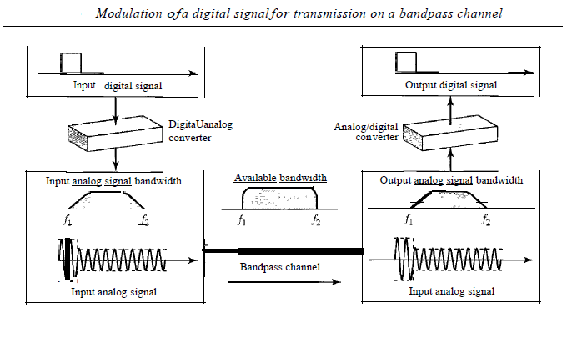
Example

Slide 44
Relationship b/w Data Rate and Bandwidth
Any transmission system ( transmitter + medium + receiver) accommodates only a limited band of frequencies
This limits the data rate that can be carried on the medium
A square waveform (digital) has an infinite no. of frequency components and hence an infinite bandwidth
Furthermore, the greater the bandwidth of a channel, the greater the cost
On the other hand limiting the bandwidth of a channel increases distortion
The higher the data rate of a signal, the greater is its required effective bandwidth
There is a direct relationship between data rate & bandwidth

Slide 45
Bandwidth
Used in two context
Bandwidth in hertz, refers to the range of frequencies in a composite signal or the range of frequencies that a channel can pass.
If a telephone channel can transmit frequencies from 300Hz to 3400Hz, it has a BW of 3100 Hz.
Bandwidth in bits per second, refers to the speed of bit transmission in a channel or link
The bandwidth of a Fast Ethernet network is a maximum of 100 Mbps. This means that this network can send 100 Mbps.
An increase in bandwidth in hertz means an increase in bandwidth in bits per second

Slide 46
Channel and Channel Capacity
A path that connects the sender and recipient, and could take the form of cables, circuits or even satellite transmission links is called a Channel
Max bit rate at which data can be transmitted on communication channel/path is called Channel Capacity
Channel capacity is a function of
data rate: rate in bits per second (bps)
Bandwidth: bandwidth in hertz or in bps
noise : average noise over communications path
error rate: rate at which errors occur
Error is the reception of 1 when 0 transmitted or 0 when 1 transmitted
We want the most efficient use of the capacity
Because the greater the bandwidth of a facility, the greater the cost
Notes:
46

Slide 47
Bandwidth categories of a Channel
Narrowband:
This is for the channels with BW less than 4000 Hz.
E.g. a telegraph channel has a BW of 200 Hz.
Voiceband:
This is the range of frequencies transmitted over a normal telephone network channel i.e. 4000 Hz.
Wideband:
Channels which have a BW exceeding 4000 Hz are usually placed under this category.

Slide 48
Other Terms
Pass Band:
a particular range of frequencies which can be passed through the transmission equipment.
e.g a telegraph circuit could have a pass band between 1200 to 1400Hz, and a BW of 200Hz.
Cut-off frequencies:
The cut-off frequencies of the telegraph channel above are 1200 Hz and 1400 Hz.
A frequency at which the attenuation of a device begins to increase sharply, such as the limiting frequency below which a traveling wave in a given mode cannot be maintained in a waveguide, or the frequency above which an electron tube loses efficiency rapidly.
Also known as critical frequency or corner frequency.

Slide 49
Throughput
It is a measure of how fast we can actually send data through a network.
Although, bandwidth in bits per second and throughput seem the same, but they are different.
In other words, the bandwidth is a potential measurement of a link; the throughput is an actual measurement of how fast we can send data.
E.g; we may have a link with a bandwidth of 1 Mbps, but the devices connected to the end of the link may handle only 256 kbps. This means that we cannot send more than 256 kbps through this link.

Slide 50
END OF WEEK 04

